Slide 1
Johnson Liu
Software Engineer, ICM
September 2014
Product Maintenance Training (PMT)
IBM Case Manager V5.2.1
Solution Development: External Properties

Slide 2
Introduction
Course Overview
  Using external properties in IBM Case Manager 5.2.1
Target Audience:
  Solution Administrators, Solution Developer, L2/L3 support, Sales/Tech Sales, GBS/GTS, Business Partners
Suggested Prerequisites:
  IBM Case Manager
© Copyright International Business Machines Corporation 2014. All Rights Reserved.
US Government Users Restricted Rights - Use, duplication or disclosure restricted by GSA ADP Schedule Contract with IBM Corp.

Slide 3
Course Roadmap
  Overview
  Hello world example
  Defining external properties in Properties View Designer
  Binding external properties using Script Adapter widget
  Saving external properties
  Course summary

Slide 4
Overview
External properties are
  Properties that define a collection of properties that is in its own collection and not associated with case properties or task properties
  Meant to be defined and saved through an external source like a servlet, JSON file, or data service
  Added to the Properties widget using script adapters
External property binding is handled by the Properties area in the Model layer

Slide 5
Overview (cont.)
What is an external property?
An external property is similar to a case property or task property with the exception that an external property can be defined outside of IBM Case Manager and then bound to the Model API layer so that the data can be rendered in the Properties widget for example.
External properties can be defined using
  External Data Services
  Java Servlets
  JSON file on mid-tier
  In-line in JavaScript

Slide 6
Overview (cont.)
General Use Case
  Most organizations maintain several “systems of record” data sources
  These data sources often contain the most current “single source of truth”
  Easy access to this information helps case workers complete their work
  It is often necessary, and efficient, to access this data live and not store a copy
Specific Use Case
  While working a claim for a customer, an agent opens the case details
  Along side the claim specific data, the agent sees the customer’s contact information, pulled live from their client database
  A list of past transactions is also conveniently displayed, saving the agent from having to access another system

Slide 7
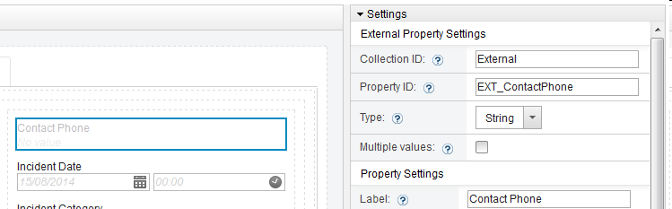
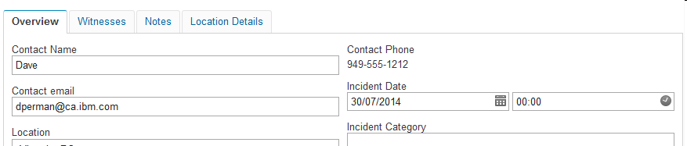
Overview (cont.)
Placeholder added to a property view
A script is added to the page that gets data from another system based on one of the existing case properties
The returned data is mixed into the view with the case properties
The external property is never persisted with the case data itself and is always accurate
External properties can be both read-only and read-write
External property placeholder added to view
External property value set at runtime

Slide 8
Course Roadmap
  Overview
  Hello World Example
  Defining external property in View Designer
  Binding external property using Script Adapter widget
  Saving external property
  Course summary

Slide 9
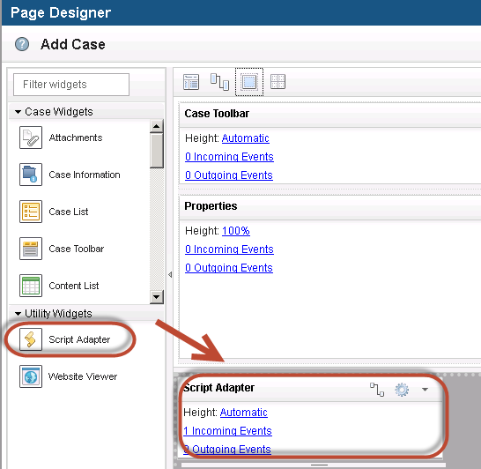
Hello World Example
This sample illustrates a simple and quick way to define and bind an external property at run-time.
Open Case Builder and on the Add Case or Case Details page, place a Script Adapter widget onto the page

Slide 10
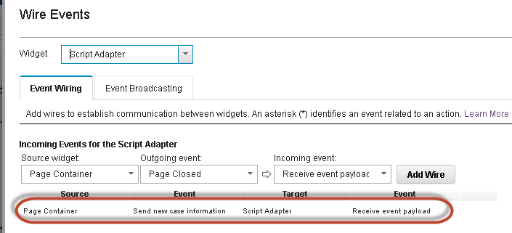
Hello World Example (cont.)
Click the Edit Wiring icon on the Script Adapter widget and wire the send new case information widget event

Slide 11
Hello World Example (cont.)
Click the Edit Settings icon on the Script Adapter widget and paste the JavaScript shown on the next slide into the window.
The JavaScript defines an external property named PhoneNumber. In the example, the external property is displayed along with other case properties.
The script on the next slide shows a simple way to define an external property

Slide 12
Hello World Example (cont.) - Simple part 1
// Get the editable from the event payload.
var editable = payload.caseEditable;
// Create the external properties model.
var model = {
properties: {
"PhoneNumber": {
id: "PhoneNumber",
name: “Phone Number”,
type: "string",
cardinality: "single",
value: "949-559-2213"
}
}
};

Slide 13
Hello World Example (cont.) - Simple part 2
// Get the collection controller for the editable.
var collectionController = ControllerManager.bind(editable);
// Add a binding for the external properties to the controller.
collectionController.bind("External", "External", model);

Slide 14
Hello World Example (cont.) - Integration part 1
The script here expands on the simple script to demonstrate the use of an integration object
// Get the editable from the event payload.
var editable = payload.caseEditable;
// Create the external properties model.
var model = {
props: {
"PhoneNumber": {
symbolicName: "PhoneNumber",
name: “Phone Number”,
type: "string",
multiValue: false,
value: "949-559-2213"
} } };

Slide 15
Hello World Example (cont.) - Integration part 2
// Get the collection controller for the editable.
var collectionController = ControllerManager.bind(editable);
// Create a custom integration object for the custom model signature.
var integration = new Integration();
integration.mergeConfiguration(basicIntegrationConfiguration);
integration.mergeConfiguration(customIntegrationConfiguration);
// Add a binding for the external properties to the controller.
collectionController.bind("External", "External", model, integration);

Slide 16
Hello World Example (cont.) - Custom part 1
The script here expands on the simple script to demonstrate the custom integration configuration required for the custom model signature
{
bindings: {
collection: {
attributes: {
properties: {
get: "props" // The properties are stored in the "props" member of the model.
}
}
},

Slide 17
Hello World Example (cont.) - Custom part 2
property: {
attributes: {
common: {
id: {
get: "symbolicName // The "id" attribute is stored as the "symbolicName" member of the model.
},
cardinality: {
get: function(model) { // The "cardinality" attribute must be computed from the "multiValue" member of the model.
return model.multiValue ? "multi" : "single";
}
}
}
}
} } }

Slide 18
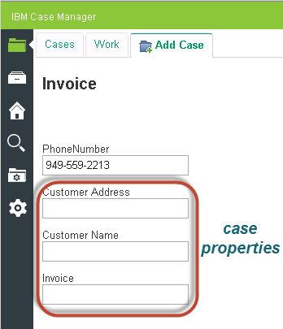
Hello World Example (cont.)
Save the page.
Save and deploy the solution updates.
Open the solution in Case Client and add a case. The external property (phone number) displays on the same page as the case properties.

Slide 19
Course Roadmap
  Overview
  Hello world example
  Adding external properties in Properties View Designer
  Binding external properties using Script Adapter widgets
  Saving external properties
  Course summary

Slide 20
Adding external properties in the Properties View Designer
You can add an external property to a view in View Designer as follows:
  Drag and drop the external property widget into the desired location in the view.
  Configure the binding for the external property by entering its expected collection ID, property ID, data type and cardinality.
  Configure the remaining settings as you would a normal case property.
Adding external properties to a custom view gives you control over their placement and style.
At runtime, the external property specified in the binding must be found in the controller. If a matching external property is not found, the external property widget is removed from the view.

Slide 21
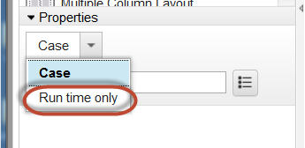
Defining external properties in the View Designer (cont.)
To add an external property to a container in the Properties View Designer:
Open the appropriate custom view
In the Properties palette, select Run time only from the drop-down list

Slide 22
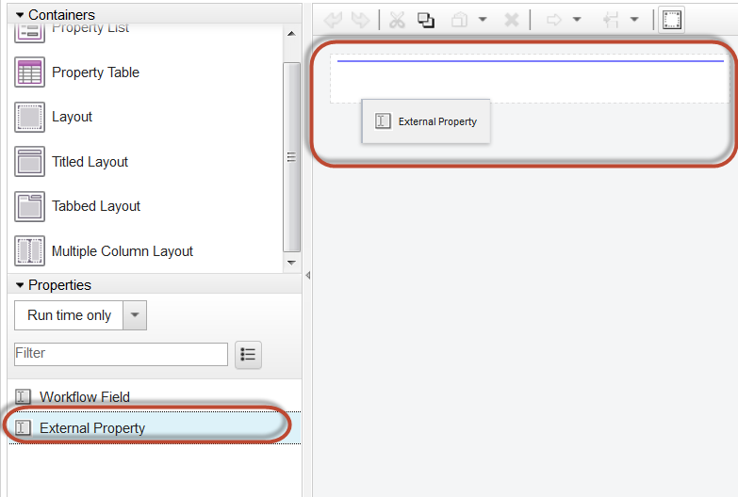
Defining external properties in the View Designer (cont.)
Drag the External Property into the container.

Slide 23
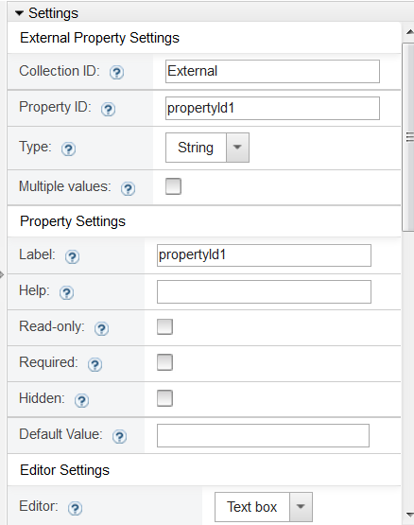
Defining external property in View Designer
Select the external property and edit the settings
Enter the collection identifier and property identifier that Case Client will use to locate the property at run time
Select the data type of the external property and define the property settings as needed

Slide 24
Defining external property in View Designer
The name of the external property collection can be anything the user chooses, but that the name entered in the view designer MUST MATCH the collection id passed as the first argument of the PropertyCollectionController.bind method.
Avoid reserved words like “F_CaseFolder”, “F_CaseTask”, and items with “F_” prefix

Slide 25
Course Roadmap
  Overview
  Hello world example
  Defining external properties in View Designer
  Binding external properties using Script Adapter widgets
  Saving external properties
  Course summary

Slide 26
Binding external properties using Script Adapter widgets
Set up wiring for the Script Adapter widget, including an incoming event that is loaded before the actual properties widget loads on the page.
For example, use the page container's
  Send new case information event for the Add Cases page
  Send case information event for the case details page
  Send work item event for the work details page

Slide 27
Binding external properties using Script Adapter widgets
Use JavaScript in the the Script Adapter widget in Page Designer in Case Builder.
Have the JavaScript trigger on an incoming event.
The JavaScript executes during run-time to define the external properties.

Slide 28
Binding external property using Script Adapter widgets (cont.)
There are two example ways to define an external property
  JSON file
  Within the JavaScript itself (known as inline)
We can define various types of external properties (as shown on the next slide)
On the next slide, we can define these external properties in a JSON file on the mid-tier or use them in-line in the JavaScript in the Script Adapter widget

Slide 29
Binding external properties using Script Adapter widgets (cont.)
{
properties: {
"description": {
id: "description",
name: "Description",
label: "Description",
type: "string",
cardinality: "single",
value: "description here"
},
"price": {
id: "price",
name: "Price",
label: "Price",
type: "float",
cardinality: "single",
value: 22.2
},
"booleantest": {
id: "booleantest",
name: "booleantest",
label: "booleantest",
type: "boolean",
cardinality: "single"
},
"datetimeTEST": {
id: "datetimeTEST",
name: "datetimeTEST",
label: "datetimeTEST",
type: "datetime",
cardinality: "single"
},
"MyMultiInteger": {
id: "MyMultiInteger",
type: "integer",
cardinality: "multi",
value: [1, 2, 3]
},
"multiCategory": {
id: "multiCategory",
name: "MultiCategory",
label: "MultiCategory",
type: "integer",
cardinality: "multi",
choices: [{
label: "Small",
value: 0
},
{
label: "Large",
value: 1
}
]
}
}

Slide 30
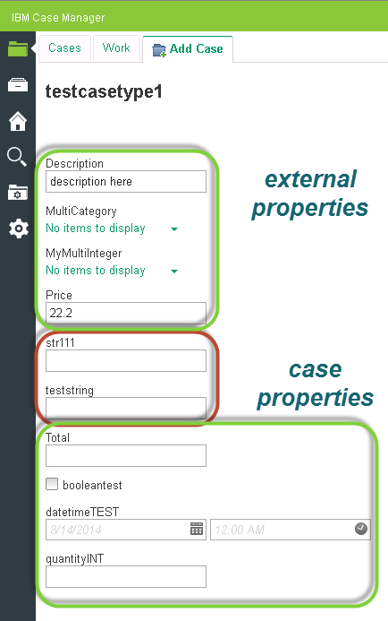
Binding external properties using Script Adapter widgets (cont.)

Slide 31
Course Roadmap
  Overview
  Hello world example
  Defining external properties in the View Designer
  Binding external properties using Script Adapter widgets
  Saving external properties
  Course summary

Slide 32
Saving external properties
External properties are defined at the Model layer and not at the Content Engine layer where case properties are defined
Use a property controller at the model layer to retrieve and persist external properties
Retrieving and persisting external properties depend entirely on your implementation of the external properties
  Where they are stored, e.g in a database
  How they are accessed, e.g. via a web service
Define methods to save the external properties when you update a value on a page

Slide 33
Saving external properties (cont.)
Here is an example of the flow of saving external properties
GetExternalProperties() and saveExternalProperties() are methods that the user provides

Slide 34
Saving external properties (cont.)
require(["icm/base/Constants", "icm/model/properties/controller/ControllerManager"], function(Constants, ControllerManager) {
/* Get the coordination and editable objects from the event payload. */
var coordination = payload.coordination;
var editable = payload.caseEditable;
/* Use the BEFORELOADWIDGET coordination topic handler to obtain the controller binding */
/* for the editable and to update the properties. */
coordination.participate(Constants.CoordTopic.BEFORELOADWIDGET, function(context, complete, abort) {
/* Obtain the controller binding for the editable. */
var controller = ControllerManager.bind(editable);

Slide 35
Saving external properties (cont.)
/* Retrieve the external properties and bind them to the controller. */
var exernalProperties = getExternalProperties(); /* You must provide this function. */
controller.bind("Ext1", "Ext1", externalProperties); /* You may optionally provide an integration object if a non-standard model is used. */
/* Call the coordination completion method. */
complete();
});

Slide 36
Saving external properties (cont.)
/* Use the SAVE coordination topic handler to release the controller binding for the editable. */
coordination.participate(Constants.CoordTopic.SAVE, function(context, complete, abort) {
/* Release the controller binding for the editable. */
ControllerManager.unbind(editable); /* Will automatically release the external properties binding. */

Slide 37
Saving external properties (cont.)
/* Save the external properties. */
saveExternalProperties(externalProperties); /* You must provide this function. */
/* Call the coordination completion method. */
complete();
});
});

Slide 38
Course Roadmap
  Overview
  Hello world example
  Defining external properties in the View Designer
  Binding external properties using Script Adapter widgets
  Saving external properties
  Course summary

Slide 39
Course Summary
You have completed this course and can:
  Use external properties in a solution
  Define external properties using JavaScript
  Save changes to external properties

Slide 40
Contacts
Product Marketing Manager:
William (Doc) Mills (wdocmills@us.ibm.com)
Product Manager:
Dave Perman (dperman@ca.ibm.com)
Support:
Ted Dullanty (tdullanty@us.ibm.com)
Subject Matter Experts (SME)/Area of Expertise:
Brent Taylor, Manpreet Kahlon, Steven Hsieh

Slide 41
Product Help/Documentation/Resources
IBM Case Manager Knowledge Center
http://www-01.ibm.com/support/knowledgecenter/SSCTJ4_5.2.1/com.ibm.casemgmttoc.doc/casemanager_5.2.1.htm?lang=en
Creating custom property editors devWorks article
https://www.ibm.com/developerworks/community/blogs/e8206aad-10e2-4c49-b00c-fee572815374/resource/ACM_LP/ExternalPropertiesICM.pdf?lang=en
Using External Properties devWorks article
https://www.ibm.com/developerworks/community/blogs/e8206aad-10e2-4c49-b00c-fee572815374/resource/ACM_LP/ExternalPropertiesICM.pdf?lang=en

